Slide 1

Catch, effort, CPUE, and bycatch
Elizabeth A. Babcock

Slide 2
Model based methods
Abundance trends from surveys or opportunistic data (e.g. fisheries) are often standardized with generalized linear models
Advantages: smooths out random noise, can handle missing strata, can be used to combine different sampling gears, remove bias due to changes in sampling, etc.
Models can also be used to estimate total catch or bycatch from a sample of the fishery (e.g. observer data) as an alternative to design-based methods.

Slide 3
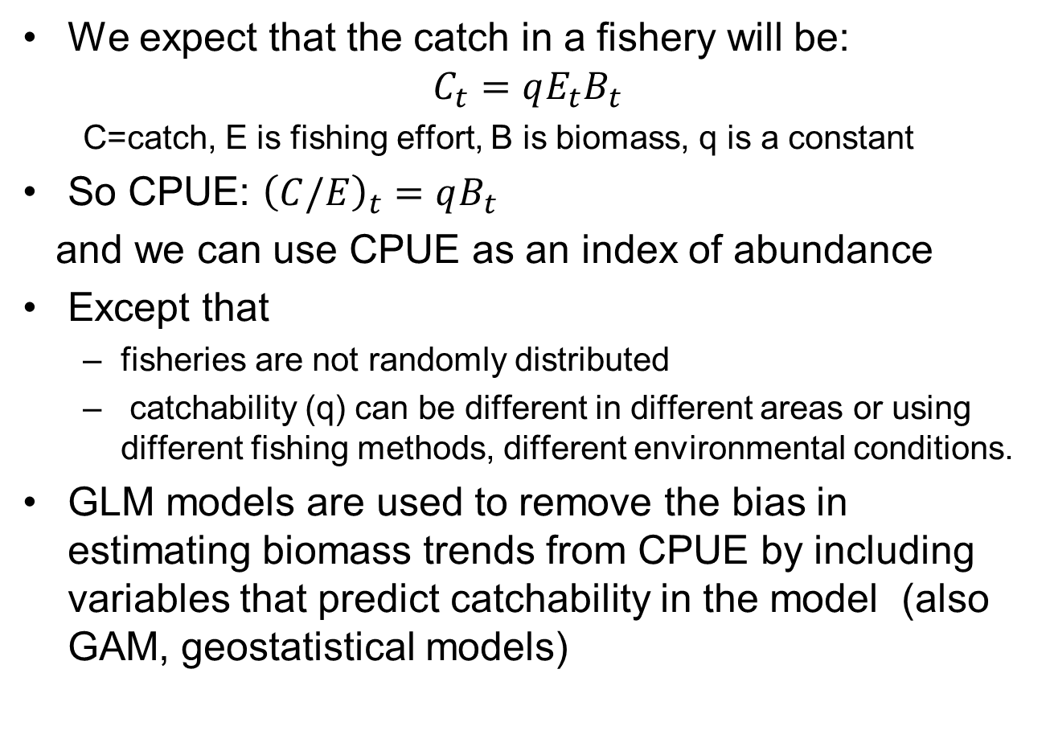
Catch per unit effort (CPUE) data
We expect that the catch in a fishery will be:
$$C_{t}=qE_{t}B_{t}$$
C=catch, E is fishing effort, B is biomass, q is a constant
So CPUE: ${\left(C/E\right)}_{t}=qB_{t}$
and we can use CPUE as an index of abundance
Except that
fisheries are not randomly distributed
catchability (q) can be different in different areas or using different fishing methods, different environmental conditions.
GLM models are used to remove the bias in estimating biomass trends from CPUE by including variables that predict catchability in the model (also GAM, geostatistical models)

Slide 4
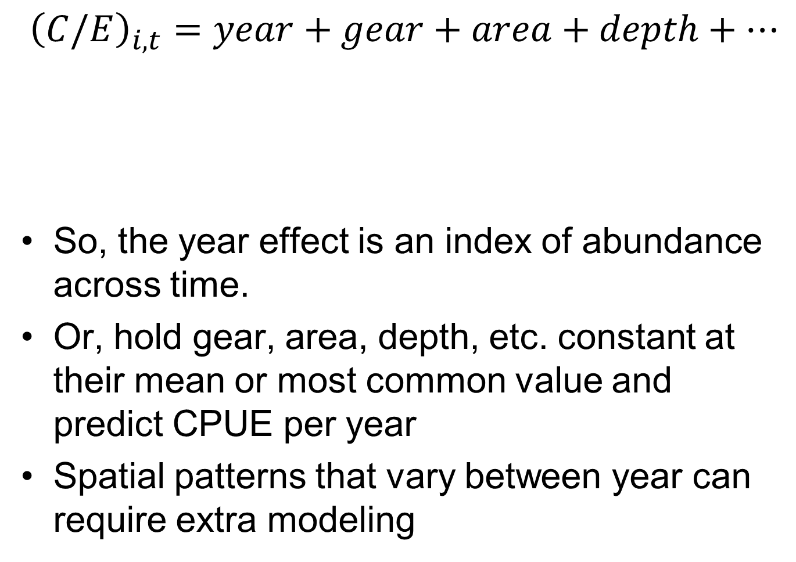
CPUE models
$${\left(C/E\right)}_{i,t}=year+gear+area+depth+…$$
So, the year effect is an index of abundance across time.
Or, hold gear, area, depth, etc. constant at their mean or most common value and predict CPUE per year
Spatial patterns that vary between year can require extra modeling
Actual change in abundance
Things that impact catchability

Slide 5
Hoyle et al. Good Practices

Slide 6
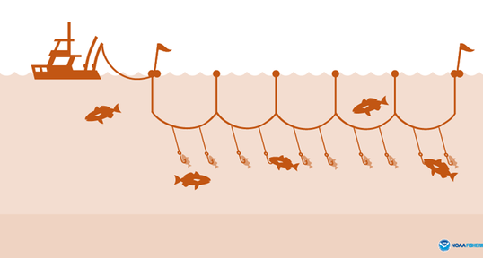
Longline fishery simulator
Simulates the approximate effort and 3D depth distribution for hooks in USA, Japan and Brazil longline fleets
Probability of catching a blue marlin on each hook based on overlap between hooks and blue marlin SDM
Goodyear 2011, 2021, etc.

Slide 7
Generalized linear models
Numbers or biomass from surveys usually have many zeros
Common generalized linear models for zero-inflated data are:
Delta-lognormal
Tweedie
Negative binomial
All of these are in glmmTMB

Slide 8
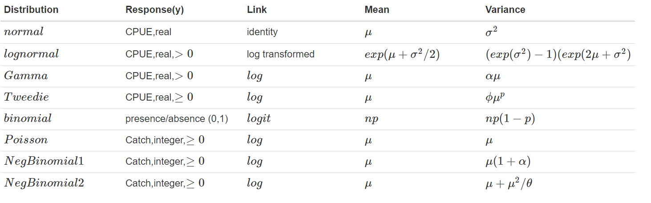
GLM characteristics

Slide 9
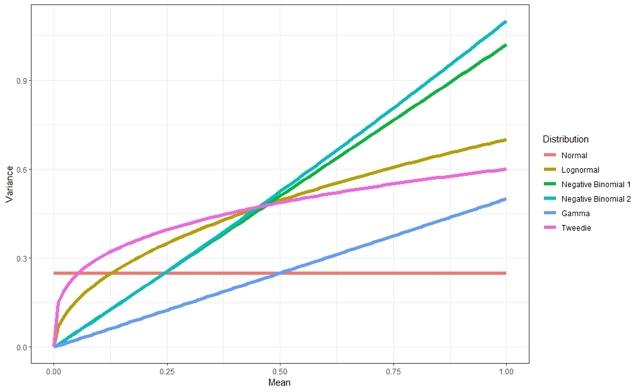
Variance vs. mean

Slide 10
Model set up
Sample unit is usually a fishing set, or fishing trip, or something more aggregated (e.g. region-month)
Need set-by-set data to use environmental variables.
If there is any stratification in the design, stratification variables should be included (e.g. if data is from a stratified random at-sea observer program)
Year is generally a factor, so there is a different estimate in each year

Slide 11
GLM standardization workflow
Plot data to find appropriate observation error model (e.g. Poisson, Tweedie)
Use quantile residuals (DHARMa) to make sure observation error model works.
Fit the model and use AIC and BIC to find best combination of predictor variables

Slide 12
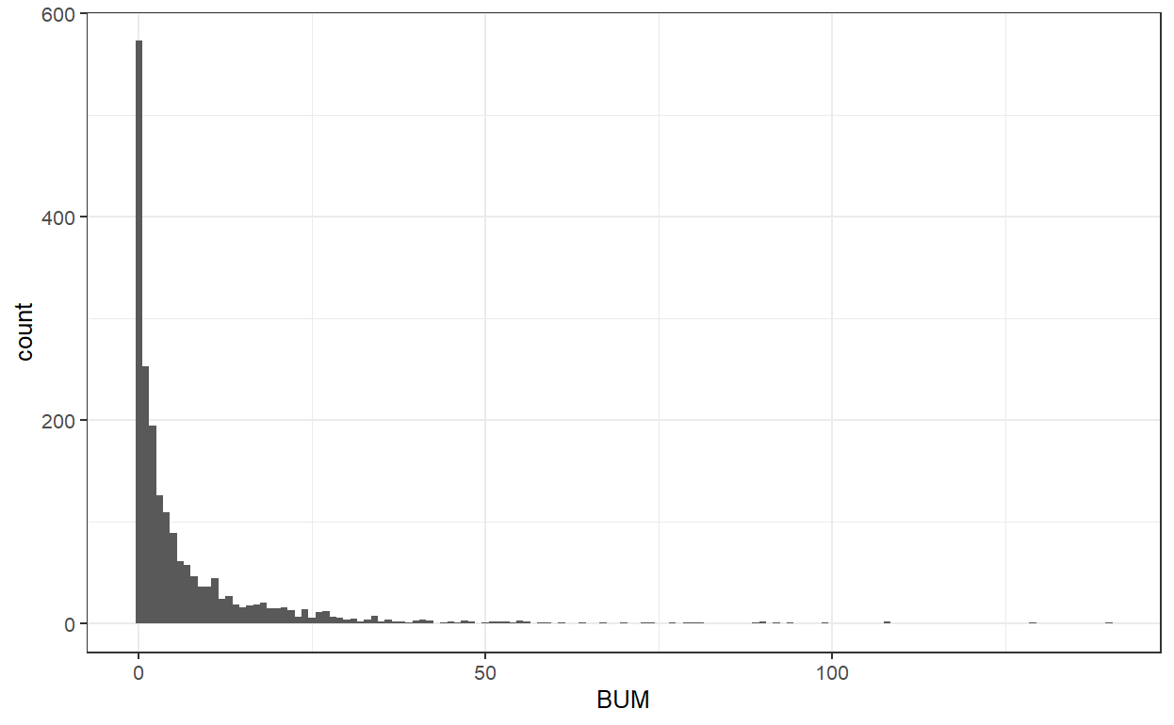
BUM data

Slide 13
For integer response
Numbers per set can be modeled with
Poisson, negative binomial 1 and 2
Poisson variance =mean, and link is log so,
log(mean)=year+gear+etc.
Both negative binomials allow for over-dispersed data, so the variance can be larger than the mean.
Estimates log(mean)=year+gear+etc. plus a dispersion parameter

Slide 14
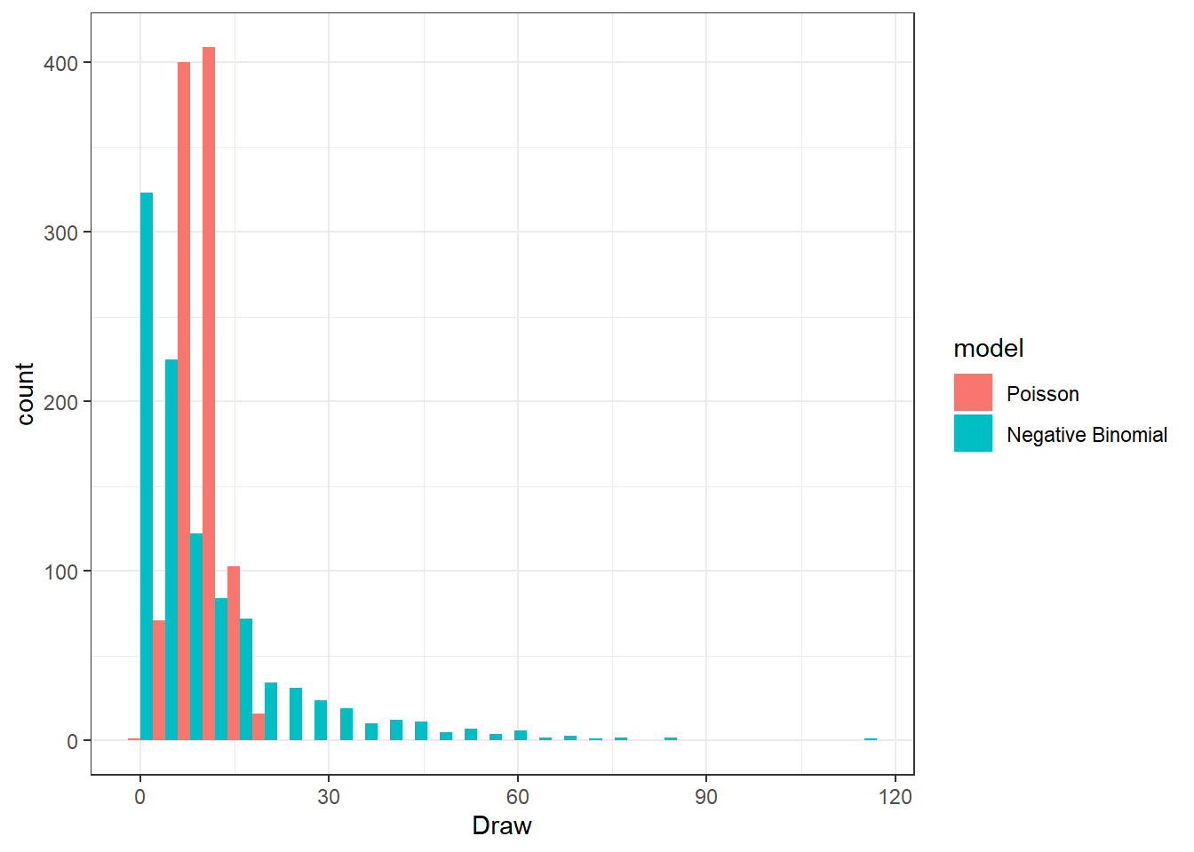
Poisson vs. NB with same mean
Negative binomial allows for more spread

Slide 15
Negative binomial models 1 and 2:
glmmTMB, family=“nbinom2” is the standard negative binomial (dnbinom in R)
variance is μ+μ²/θ
family=“nbinom1” is a modern alternative
variance = μ(1+α)
Both work well for count data, even with many zeros
Can apply to biomass data if you round to an integer

Slide 16
Offsets for Poisson, NB1, NB2
Used for any model of count data where sampling area or effort varies
e.g. counts in transects with variable area,
fishing sets with different numbers of hooks
CPUE model would be
log(C_{i}/E_{i})=b₀+b₁x₁
Which is
log(C_{i}) – log(E_{i})=b₀+b₁x₁
So
log(C_{i}) =b₀+b₁x₁ + log(E_{i})
In R code, the keyword “offset” is used distinguish offsets from predictor variables, e.g.
y ~ x₁ + offset(log(Effort))

Slide 17
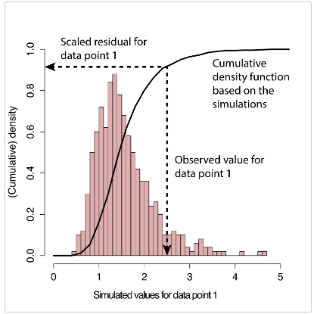
Model diagnostics – quantile residuals from DHARMa
Simulate new response data from the fitted model for each observation
For each observation, calculate the fraction of simulated data less than the true observation (i.e. quantile residual)
https://cran.r-project.org/web/packages/DHARMa/vignettes/DHARMa.html

Slide 18
Model diagnostics – DHARMa residuals
A residual of 0 means that all simulated values are larger than the observed value
A residual of 0.5 means half of the simulated values are larger than the observed value
Values of 0.5 are expected, and values should be uniformly distributed between 0 and 1
https://cran.r-project.org/web/packages/DHARMa/vignettes/DHARMa.html

Slide 19
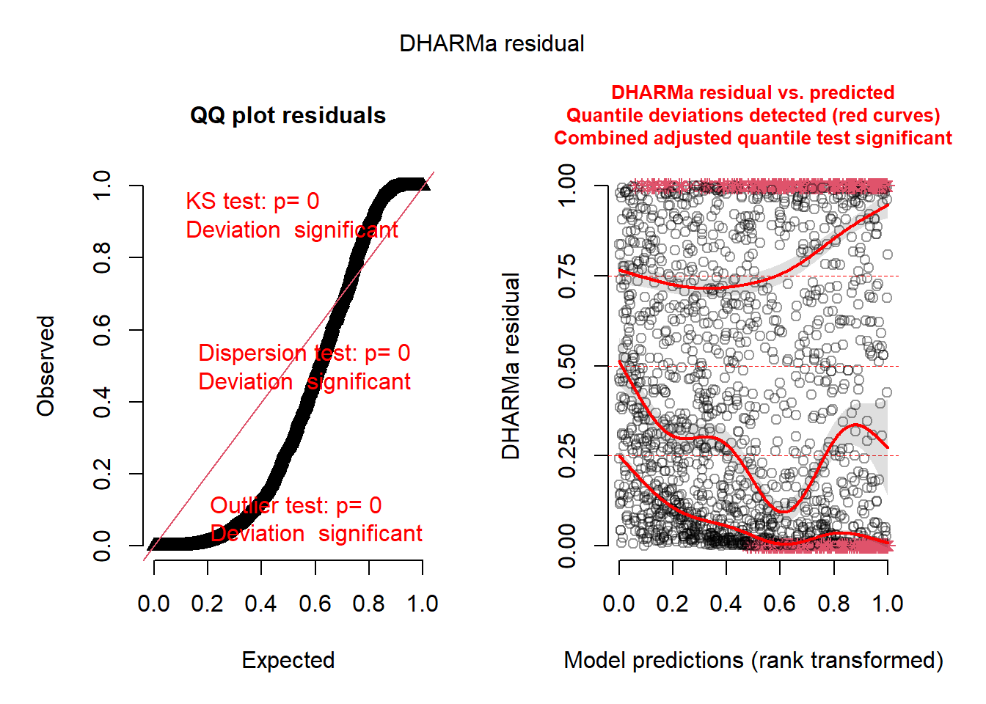
Bad residuals: Poisson

Slide 20
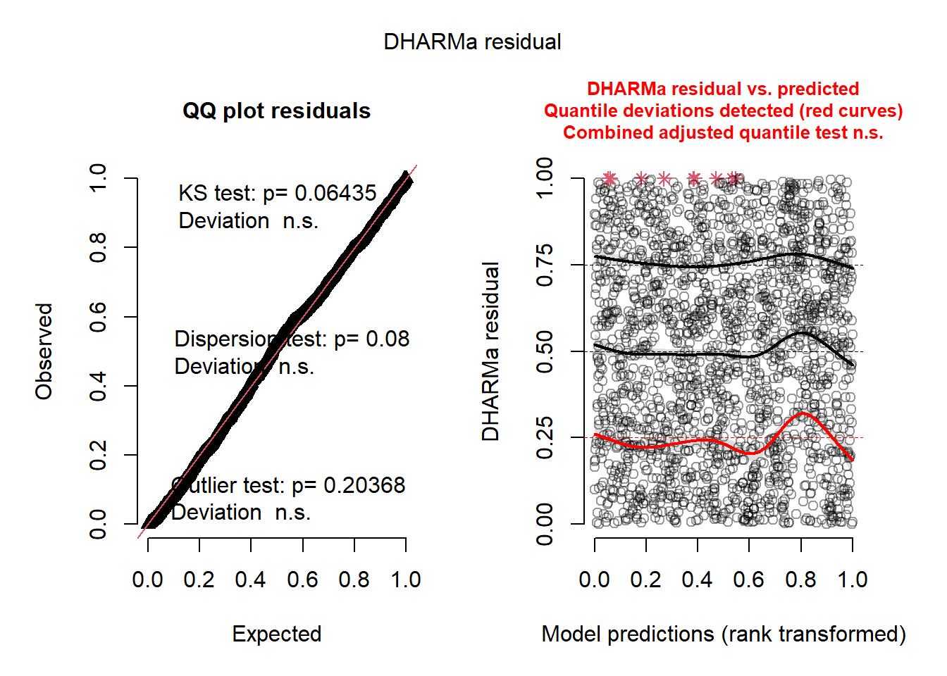
Best: NB2

Slide 21
Model selection
Library MuMIN, dredge() function will make a model selection table with all possible combinations of predictor variables from input model.
Must set up GLM to fail if there are any NA values, because IC can only be used on models with the exact same data (GLM drops rows with NA in included variables).
Can choose IC to use.

Slide 22
Dredge table
int | area | season | year | are: ssn | are: Yer | df | logLik | BIC | delta | weight
-0.24 | + | + | + | + |  | 37 | -5074.41 | 10429.70 | 0.00 | 1
-0.06 | + | + | + |  |  | 34 | -5102.23 | 10462.60 | 32.88 | 0
-0.19 | + | + |  |  |  | 31 | -5117.09 | 10469.50 | 39.82 | 0
-1.04 | + | + | + | + | + | 65 | -5010.00 | 10513.50 | 83.78 | 0
-0.43 | + | + |  |  |  | 33 | -5142.43 | 10535.40 | 105.67 | 0
-0.57 | + |  |  |  |  | 30 | -5158.52 | 10544.80 | 115.08 | 0

Slide 23
Abundance trend
Make a new data frame from all the catchability variables set to their mean (if numeric) or most common value (categorical)
Predict catch for 1 set (=CPUE) for all years, using type=“response” to get the inverse link (original scale)

Slide 24
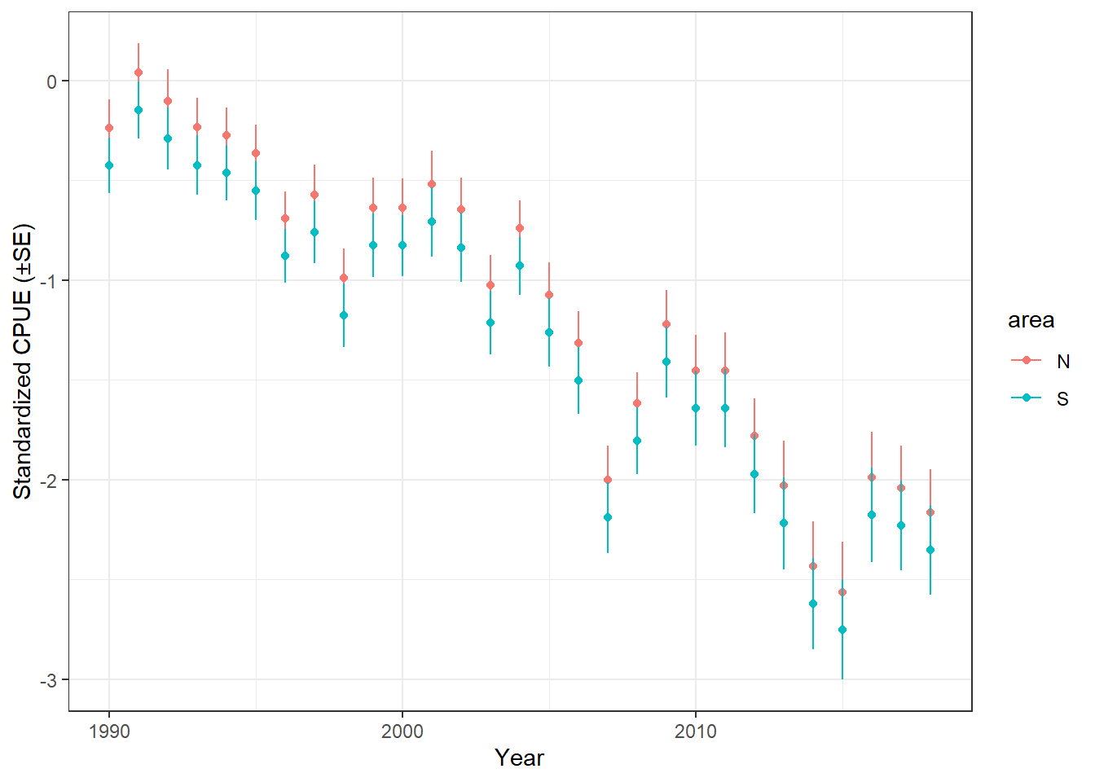
Trends from Negative binomial
Two areas are the same because there is no interaction

Slide 25
For numeric response variables
Models that can include non-integer data (e.g. biomass or C/E), and allow plenty or zeros
Tweedie
Delta-lognormal and delta-gamma

Slide 26
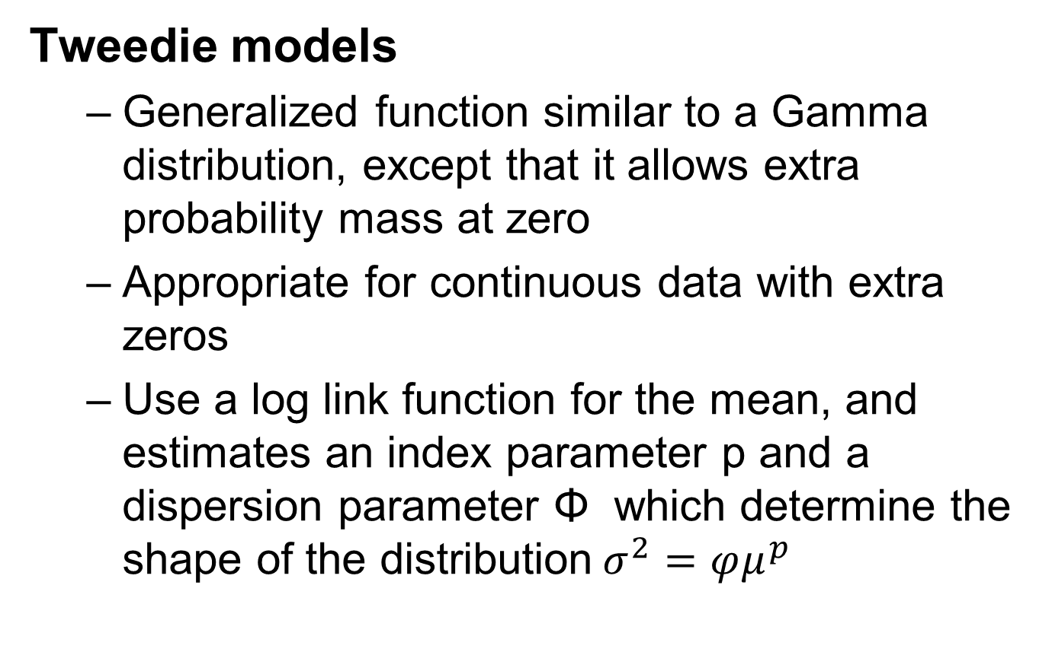
Tweedie models
Generalized function similar to a Gamma distribution, except that it allows extra probability mass at zero
Appropriate for continuous data with extra zeros
Use a log link function for the mean, and estimates an index parameter p and a dispersion parameter Φ which determine the shape of the distribution$σ^{2}=φμ^{p}$

Slide 27
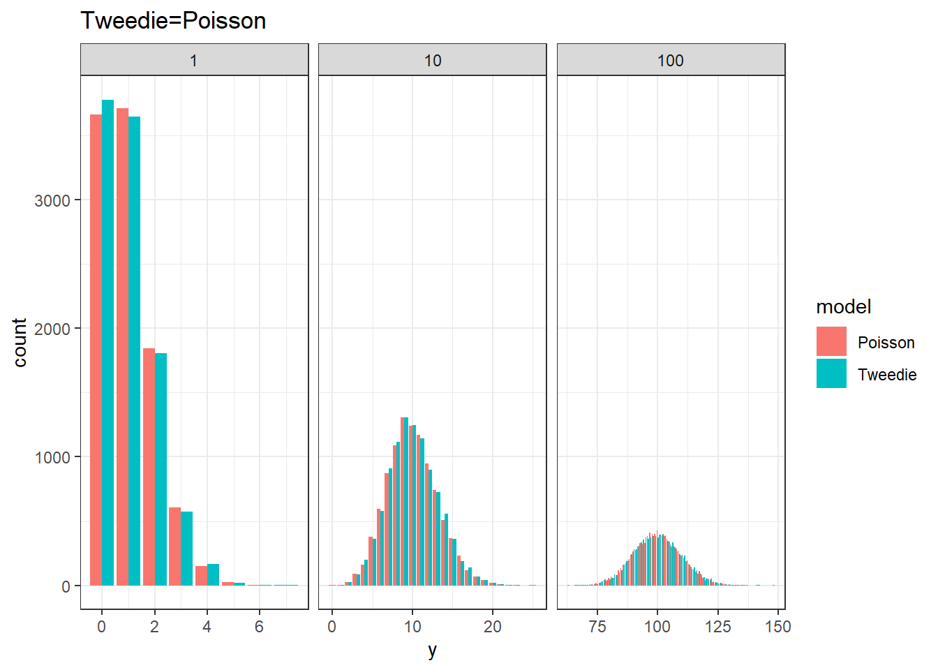
phi=1, mu=1, Tweedie=Poisson

Slide 28
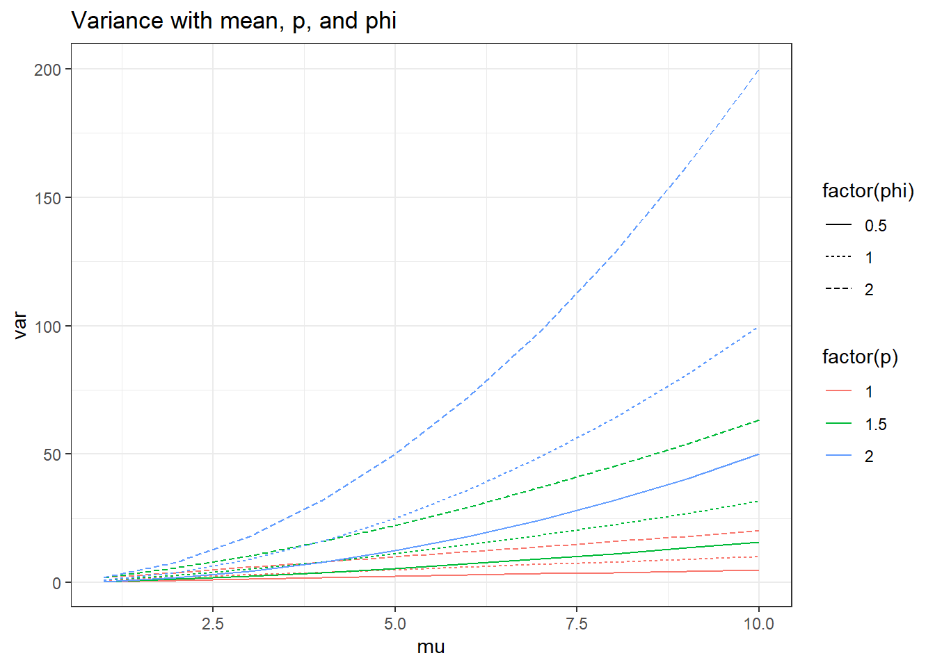

Slide 29
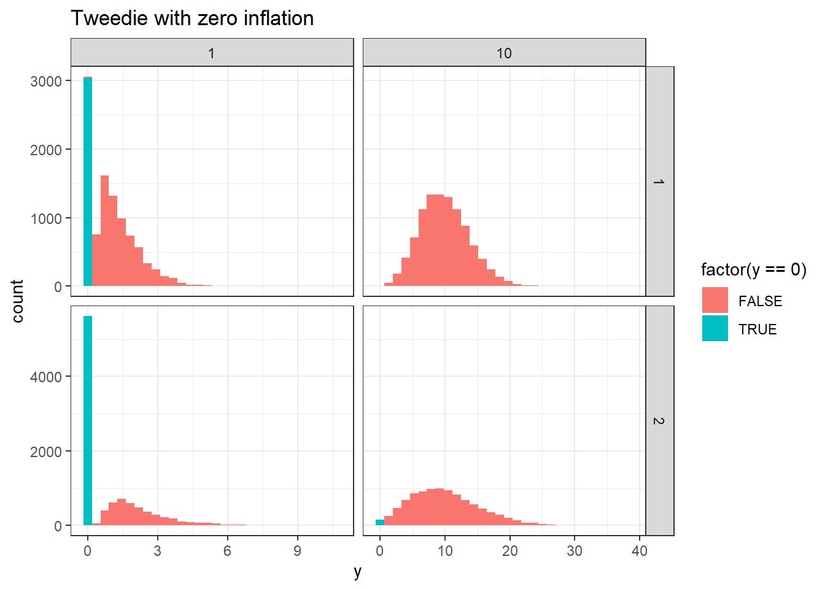
p=1.15, varying mu and phi.
phi
Mu

Slide 30
Using Tweedie
Response is CPUE, zeros are okay
Log link, so predict with type=“response”
BIC prefers same set of predictor variables

Slide 31
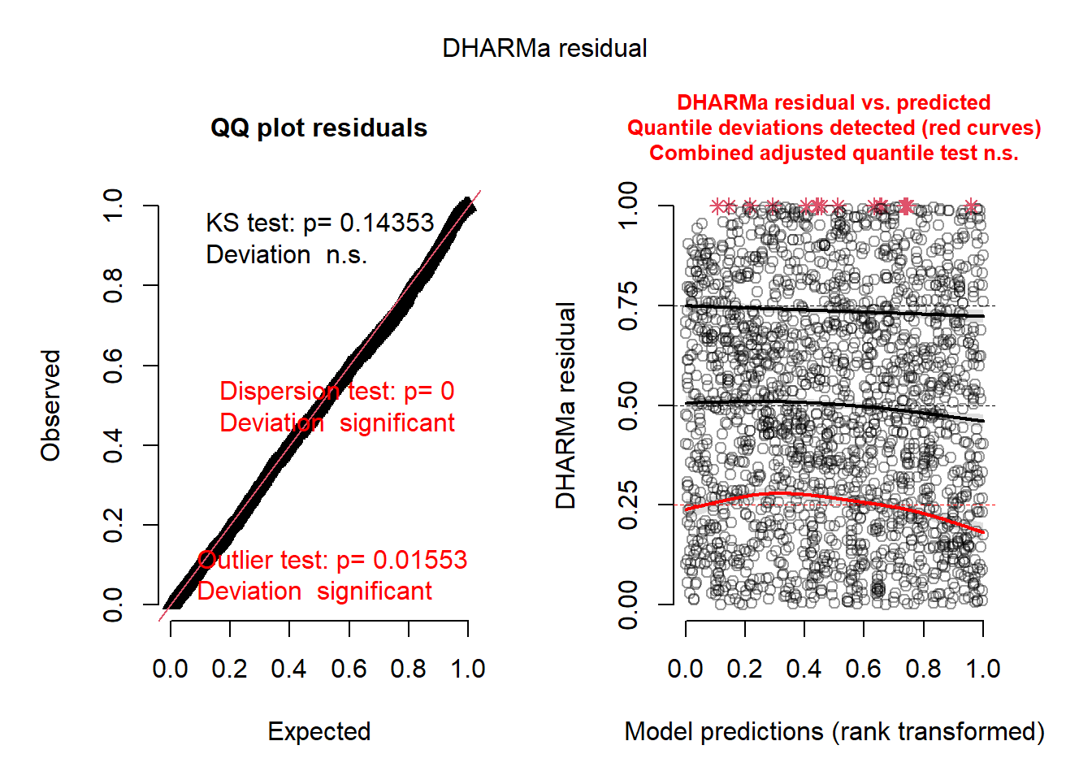
Residuals okay

Slide 32
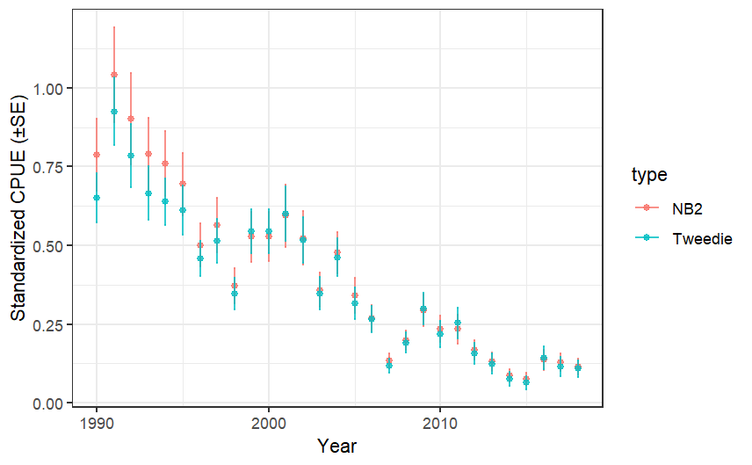
Comparing Tweedie and NB2

Slide 33
Delta models
In fisheries, called a delta model, e.g. delta-lognormal
Ecologists call these hurdle models
Two part model
Binomial model of presence/absence (year effect p)
Lognormal model for positive observations only (year effect mu)
Model selection, evaluation, testing done separately for the two models
Works for intermediate number of zeros

Slide 34
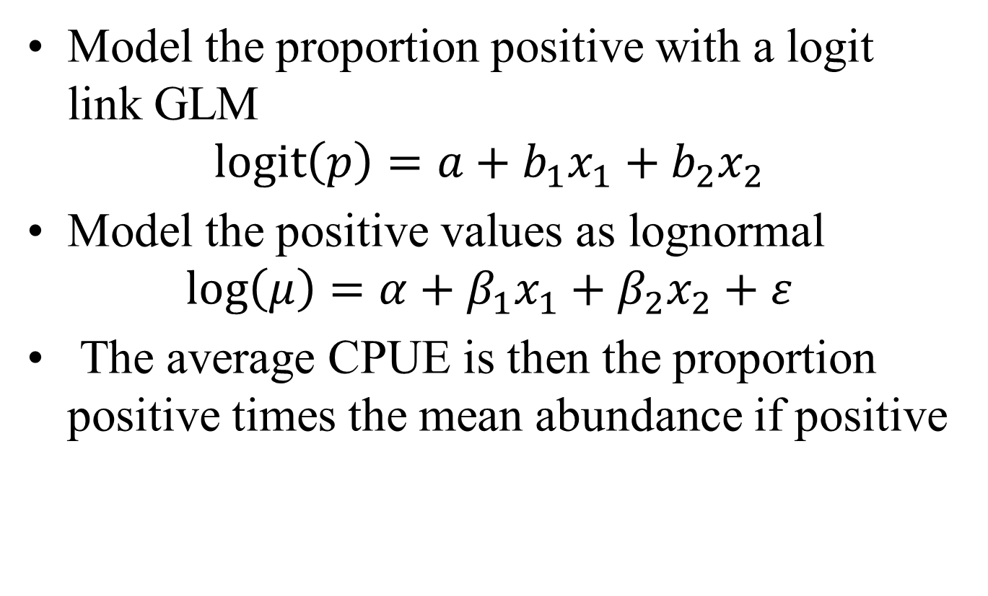
Delta lognormal GLM for CPUE
Model the proportion positive with a logit link GLM
$$\operatorname{logit}\left(p\right)=a+b_{1}x_{1}+b_{2}x_{2}$$
Model the positive values as lognormal
$$\log\left(μ\right)=α+β_{1}x_{1}+β_{2}x_{2}+ε$$
The average CPUE is then the proportion positive times the mean abundance if positive

Slide 35
Delta lognormal workflow
Run logit link binomial on presence/absence
check residuals and find best model,
Predict probability of positive catch (p)
Run normal on log(CPUE) for positive sets
check residuals and find best model,
Predict probability of positive catch (p)
Use lognormal mean and variance formulas to get mean and se in original (not log) scale
Index calculations
mean CPUE= p*(mean if positive)
Use delta method to get standard error

Slide 36

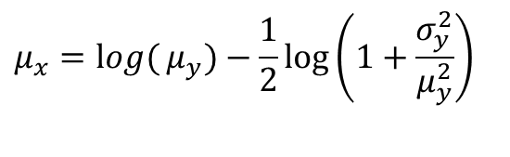

Converting means and variances between normal and lognormal
The lognormal distribution’s parameters are the mean and standard deviation σ of the Normal variable x=log(y), sometimes called log-mean and log-sigma
If y is a lognormal variable, then x =log(y) is a Normal variable with mean μ_{x} and standard deviation σ_{x}
$$μ_{x}=\log{(}μ_{y})−\frac{1}{2}\log\left(1+\frac{σ_{y}^{2}}{μ_{y}^{2}}\right)$$
$$σ_{y}^{2}=e^{2μ_{x}}e^{σ_{x}^{2}}\left(e^{σ_{x}^{2}}−1\right)$$
$$σ_{x}^{2}=\log\left(1+\frac{σ_{y}^{2}}{μ_{y}^{2}}\right)$$

Slide 37
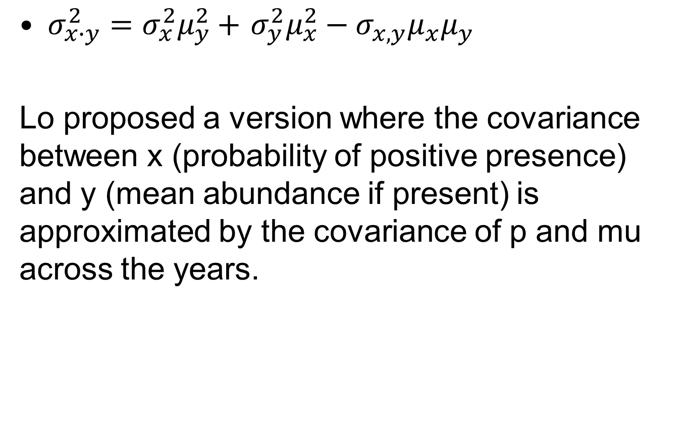
Delta method variance (Lo et al. 1992)
$σ_{x∙y}^{2}=$ $σ_{x}^{2}μ_{y}^{2}+$ $σ_{y}^{2}μ_{x}^{2}−σ_{x,y}μ_{x}μ_{y}$
Lo proposed a version where the covariance between x (probability of positive presence) and y (mean abundance if present) is approximated by the covariance of p and mu across the years.

Slide 38
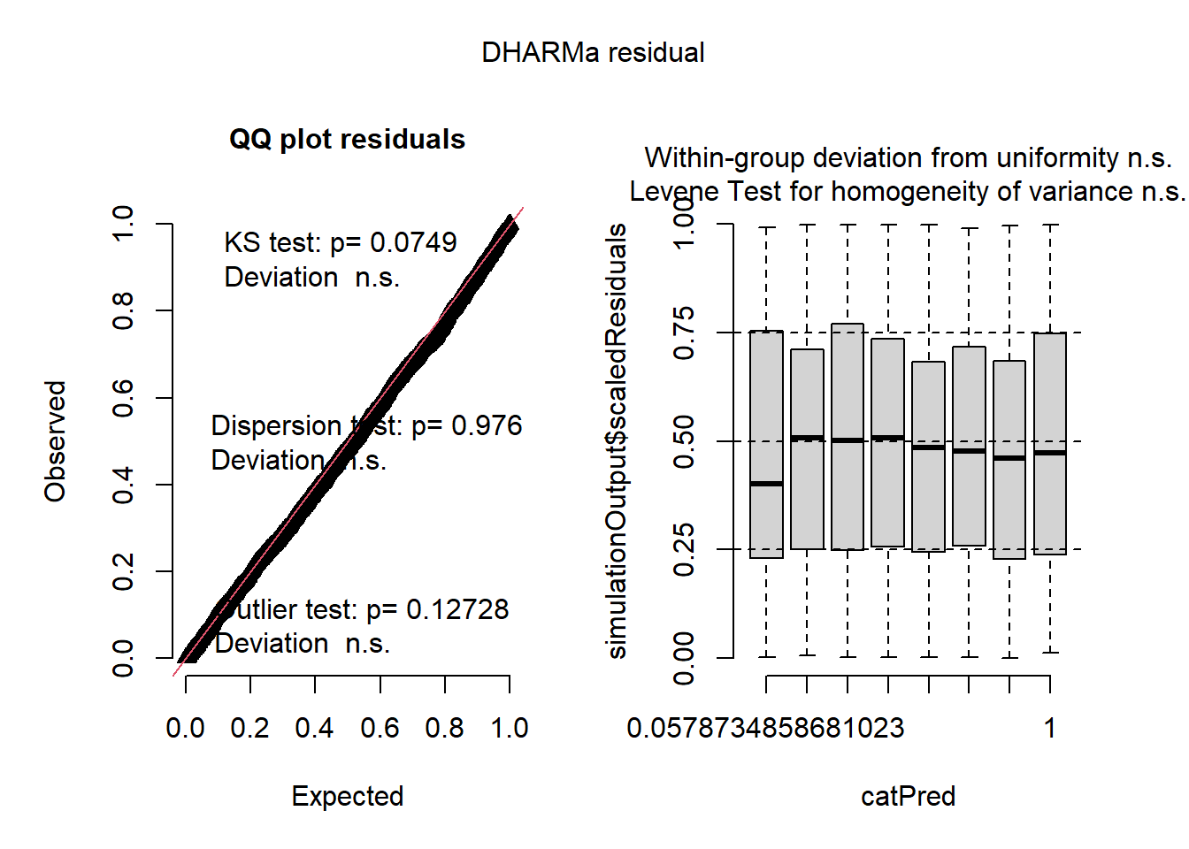
Binomial
Binomial best model does not include year.
cnd((Int)) | dsp((Int)) | cnd(are) | cnd(ssn) | cnd(Yer) | cnd(are:ssn) | df | logLik | BIC | delta | weight
1.80 | + | + | + |  | + | 8 | -1088.71 | 2238.2 | 0 | 1
2.15 | + | + | + |  |  | 5 | -1117.75 | 2273.5 | 35.29 | 0
1.83 | + |  | + |  |  | 4 | -1139.53 | 2309.4 | 71.27 | 0
1.78 | + | + | + | + | + | 36 | -1033.07 | 2339.5 | 101.3 | 0
1.32 | + | + |  |  |  | 2 | -1163.53 | 2342.3 | 104.09 | 0
2.03 | + | + | + | + |  | 33 | -1060.41 | 2371.4 | 133.21 | 0

Slide 39
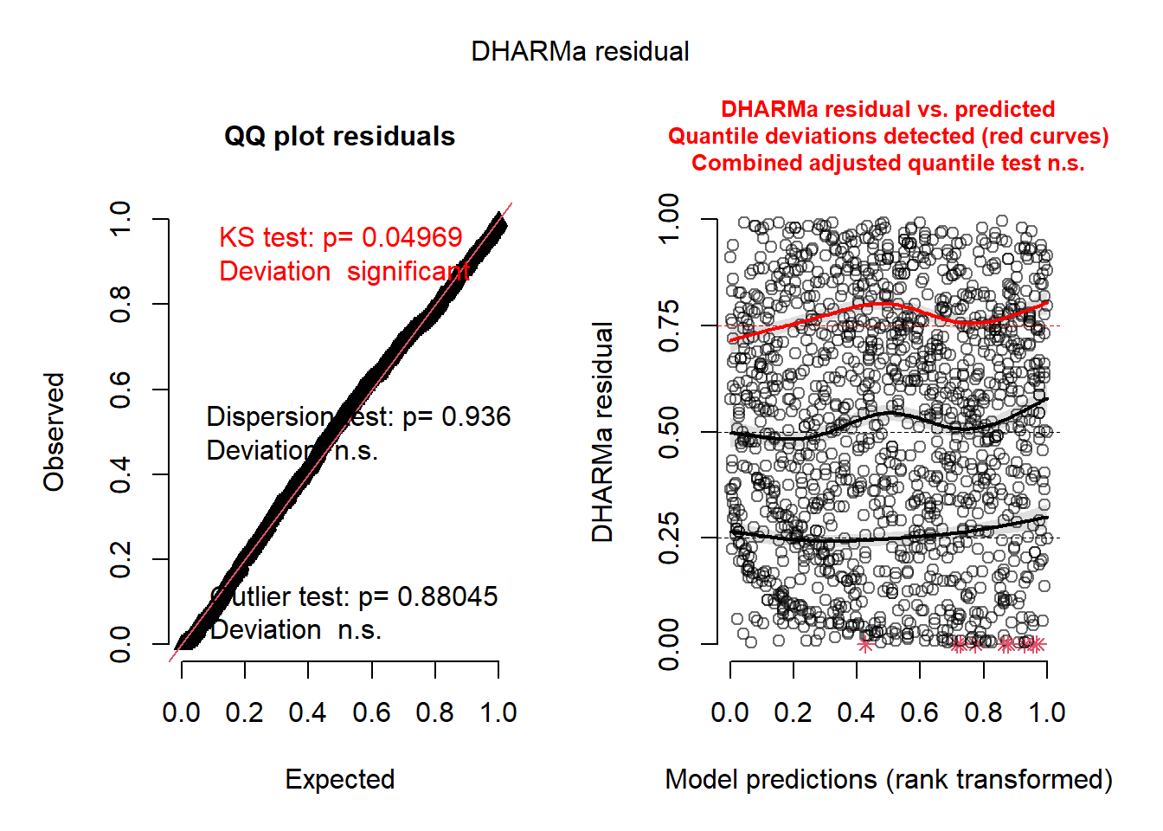
log(CPUE) positive
Includes year
cnd((Int)) | dsp((Int)) | cnd(are) | cnd(ssn) | cnd(Yer) | cnd(are:ssn) | df | logLik | BIC | delta | weight
-0.65 | + | + | + | + | + | 37 | -1932.09 | 4132.50 | 0.00 | 0.997
-0.59 | + | + | + | + |  | 34 | -1948.79 | 4144.10 | 11.64 | 0.003
-0.69 | + |  | + | + |  | 33 | -1956.18 | 4151.70 | 19.16 | 0
-0.66 | + | + |  | + |  | 31 | -1965.63 | 4156.10 | 23.57 | 0
-0.78 | + |  |  | + |  | 30 | -1974.85 | 4167.20 | 34.74 | 0
-1.23 | + | + | + |  | + | 9 | -2094.10 | 4253.50 | 120.97 | 0

Slide 40
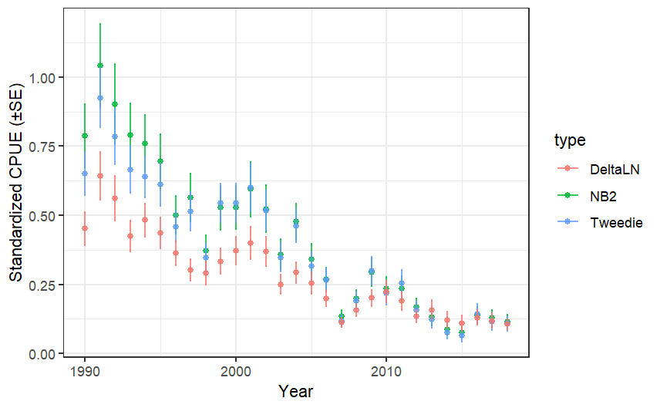
Combined index

Slide 41
How to select observation error model
I tend to use negative binomial 2 for counts and Tweedie for biomass.
Delta-lognormal is common, but a lot of extra work. Useful if you want to have different variables to predict habitat area vs. catch if in habitat area. (Zero inflated models also work for this)
All will give similar results
AIC, etc. can’t help, because these models have different response variables (count, CPUE, presence/absence plus CPUE)

Slide 42
Some fine points of CPUE standardization
How to deal with interactions between variables (e.g area) and Year
Treat area x year as a random effect
Use GAMs on latitude and longitude to take out the spatial patterns
Use geostatistical models to model the spatial patterns

Slide 43
Including random effect
Each area:year is treated as a random draw of a normal variable with a mean of zero.
Thus the estimated year effect is for a “typical” area

Slide 44
GAM and geostatistics
GAM (mgcv library)
Make smooth on latitude and longitude
Models pattern of species in space so that the year effect is not affected by where the data happen to be each year.
Geostatistical models (sdmTMB library)
Same with more complex model of the correlation as a function of distance
Integrates local density across landscape to get annual index

Slide 45
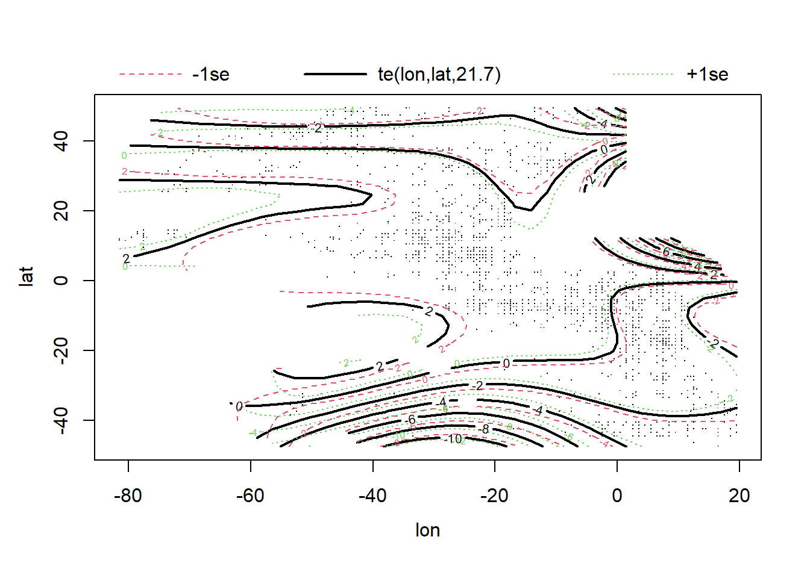
GAM on lon/lat

Slide 46
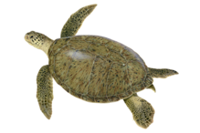
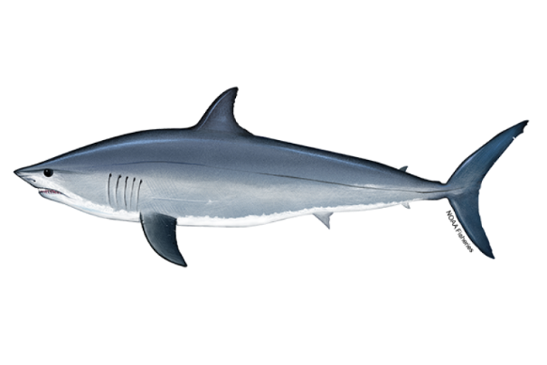
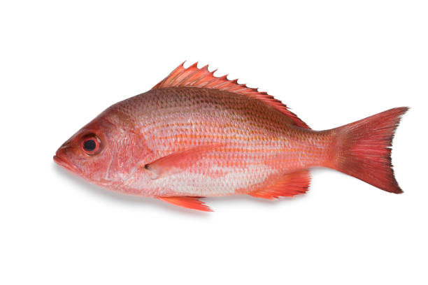
The bycatch problem in fisheries
Bycatch: any catch that is unintentional and generally not retained
Protected species
Prohibited species
Discards

Slide 47
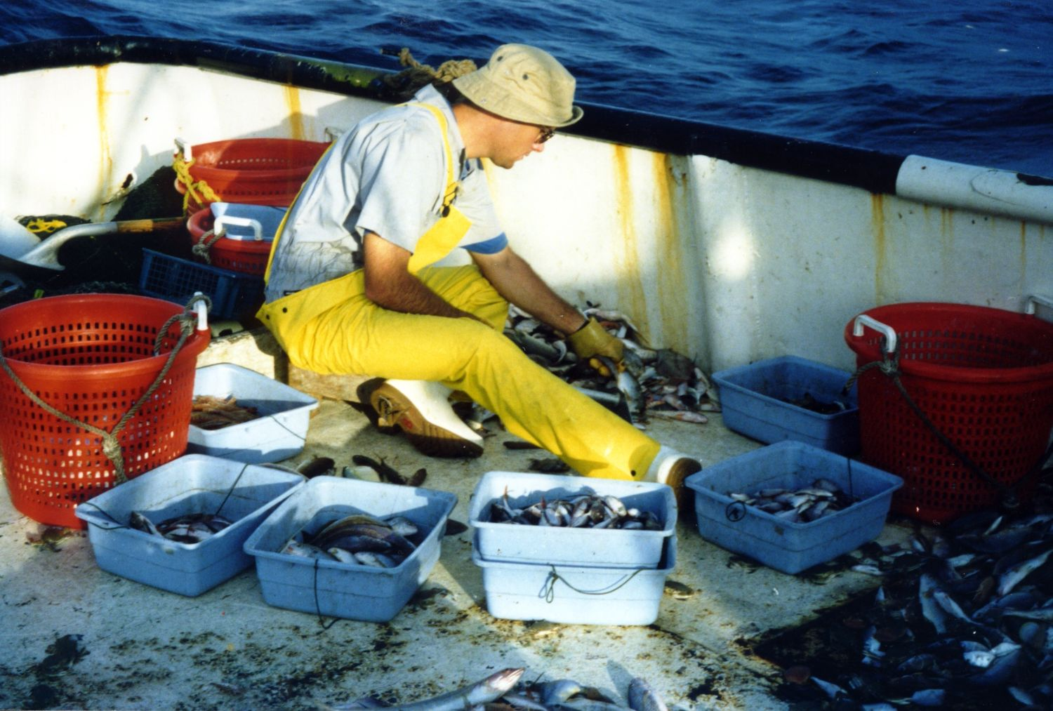
Total bycatch estimation
Need good estimates of total bycatch mortality for
endangered species assessments
fishery stock assessments
Observer data for bycatch rates
Logbooks for total effort
noaa.gov

Slide 48
Total bycatch estimation
Observer data (sample)
Estimate bycatch rate (bycatch/effort) per strata
Logbook data
Estimate total effort per strata
Bycatch per strata
Strata bycatch = bycatch rate * total effort
Total bycatch per year
Total bycatch=sum(Strata bycatch)

Slide 49
Kinds of estimation mothods
Design-based estimators
directly from data
Model-based methods
prediction from a statistical model

Slide 50
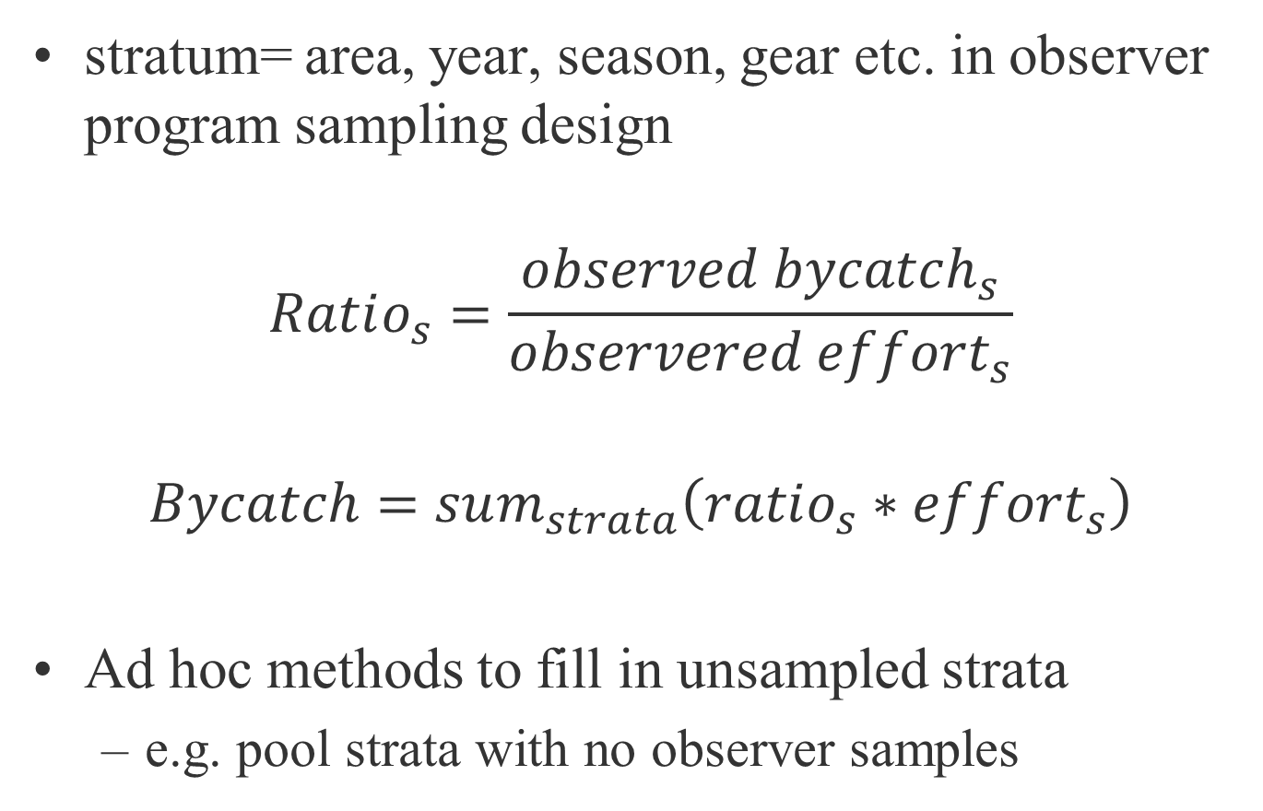
Stratified ratio estimator (design-based)
stratum= area, year, season, gear etc. in observer program sampling design
$$Ratio_{s}=\frac{observed bycatch_{s}}{observered effort_{s}}$$
$$Bycatch=sum_{strata}\left(ratio_{s}∗effort_{s}\right)$$
Ad hoc methods to fill in unsampled strata
e.g. pool strata with no observer samples

Slide 51
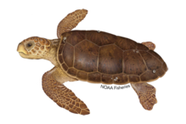
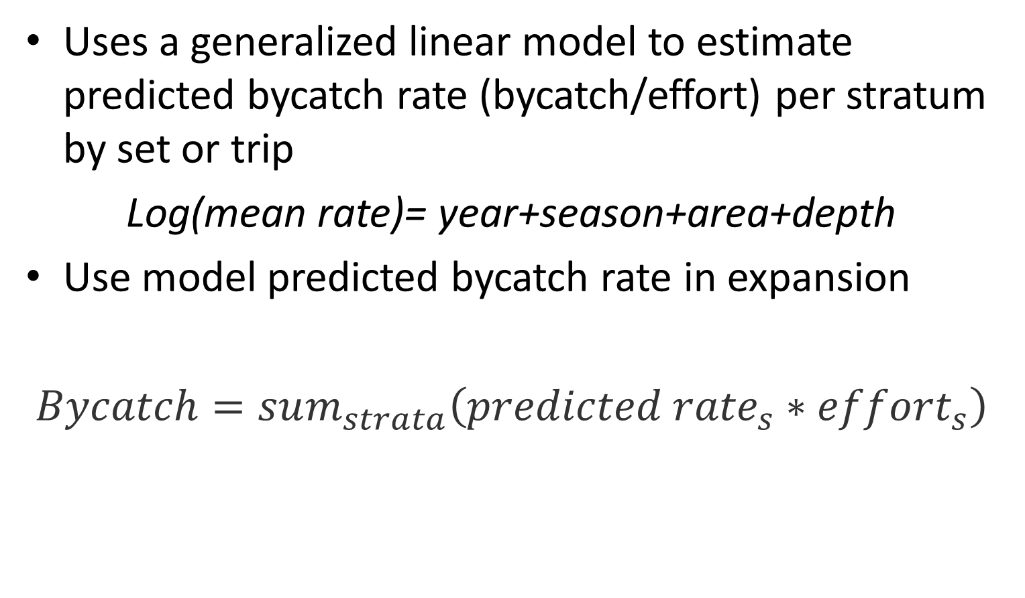
Model based estimation
Uses a generalized linear model to estimate predicted bycatch rate (bycatch/effort) per stratum by set or trip
Log(mean rate)= year+season+area+depth
Use model predicted bycatch rate in expansion
$Bycatch=sum_{strata}\left({predicted rate}_{s}∗effort_{s}\right)$
Babcock et al 2018

Slide 52
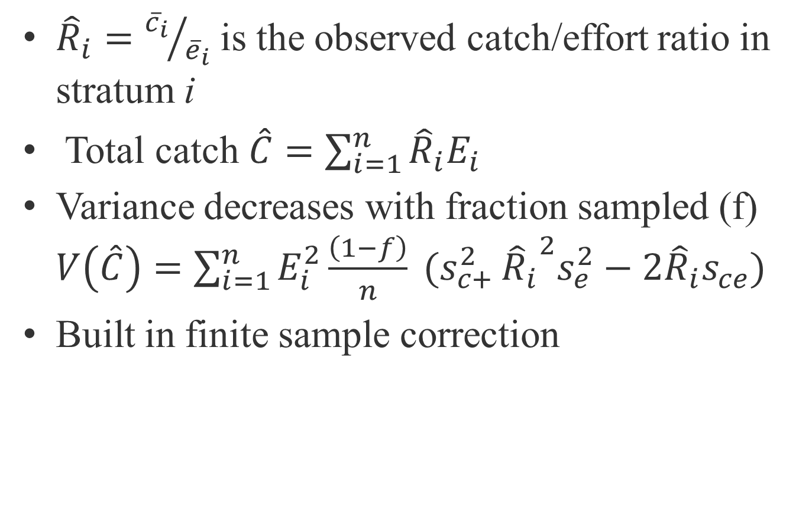
Stratified ratio estimator variance
${\hat{R}}_{i}={{\overline{c}}_{i}}/{{\overline{e}}_{i}}$ is the observed catch/effort ratio in stratum i
Total catch $\hat{C}=\sum_{i=1}^{n}{{\hat{R}}_{i}E_{i}}$
Variance decreases with fraction sampled (f) $V\left(\hat{C}\right)=\sum_{i=1}^{n}{E_{i}^{2}\frac{\left(1−f\right)}{n} (s_{c+}^{2}}{{\hat{R}}_{i}}^{2}s_{e}^{2}−2{\hat{R}}_{i}s_{ce})$
Built in finite sample correction

Slide 53
Pooling
If a stratum has too few observation, then the bycatch ratio must be imputed
Estimate bycatch pooled across all areas, allocate fraction to area 3 based on relative total effort
Area 1
95 samples
Use unpooled estimate
Area 2
26 samples
Area 3
0 samples
Use pooled estimate

Slide 54
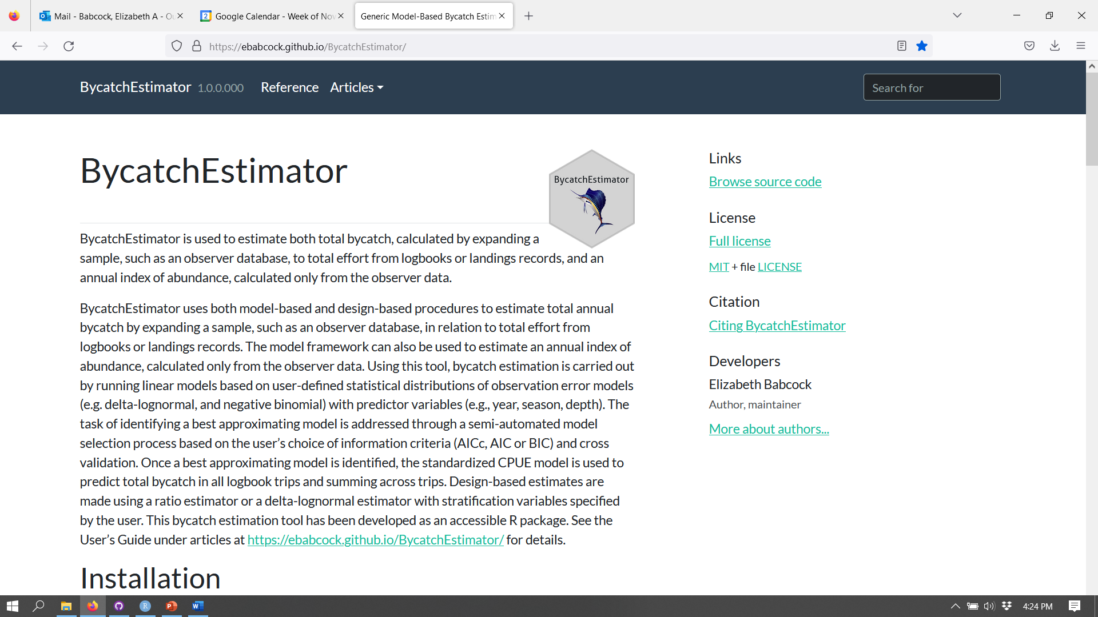
Semi-automate the process
https://github.com/ebabcock/BycatchEstimator
Babcock et al 2022

Slide 55
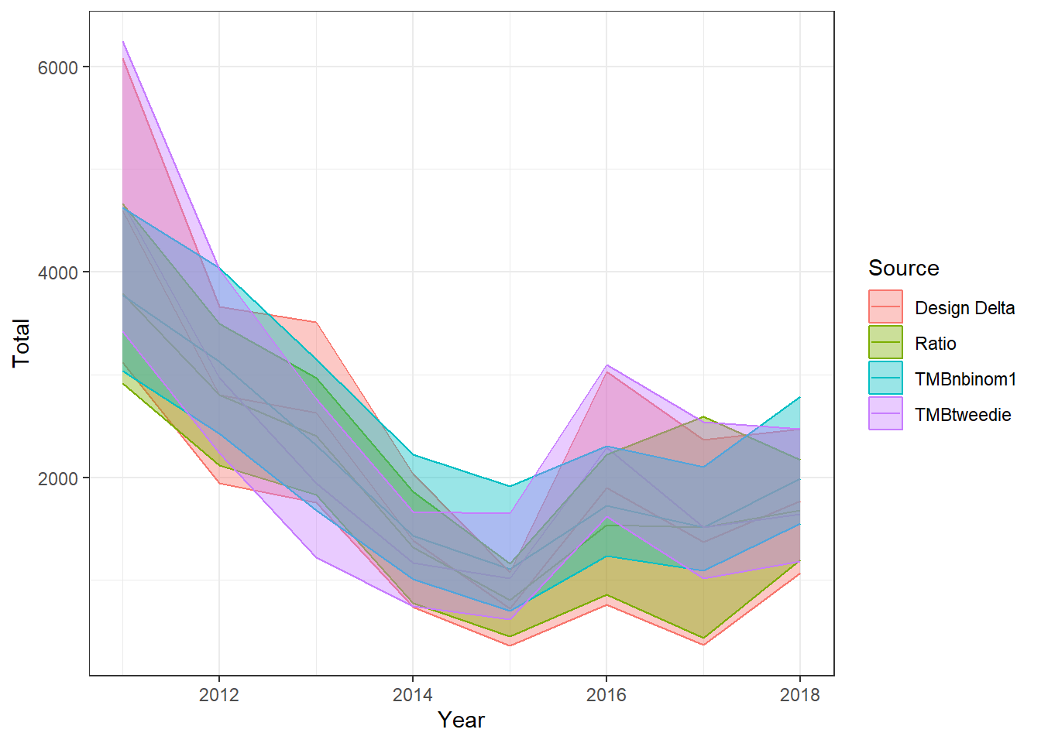
For BUM simulation
https://ebabcock.github.io/BycatchEstimator/

